Slide 1
MR YAKUBU PROMOTION
PROMOTION ASSIGNMENT

Slide 2
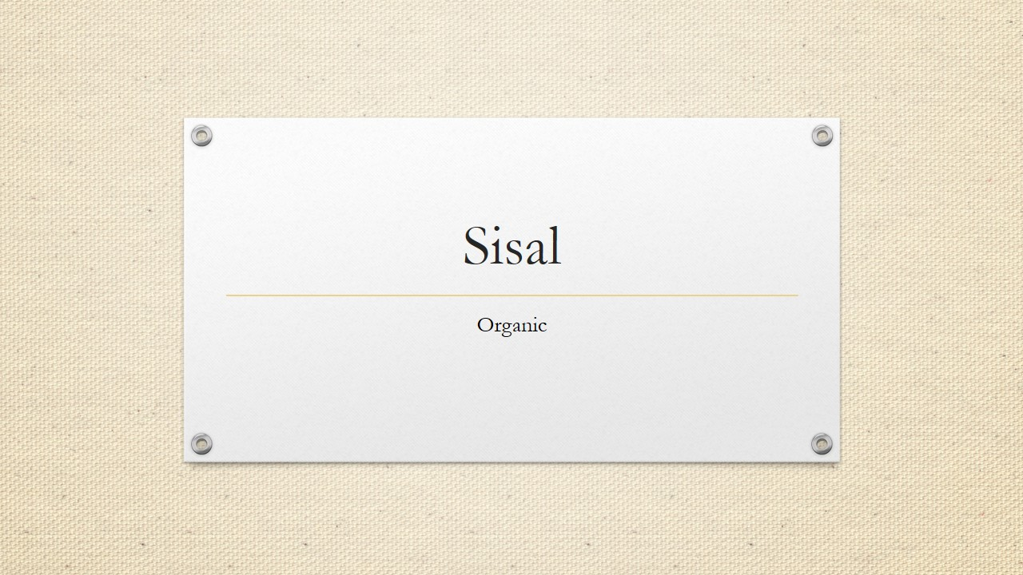
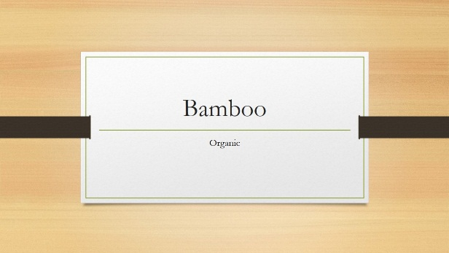
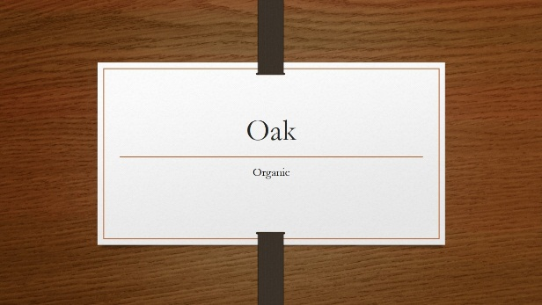
PROBLEM DESCRIPTION
Complain from staff that promotion technique is done in a bias format
Consults a Data Scientist for help
Data scientist collects information about the companies previous promotion, including things like school attended by the staff, gender, marital status and other things
In this presentation only 9 features were used for this Analysis

Slide 3


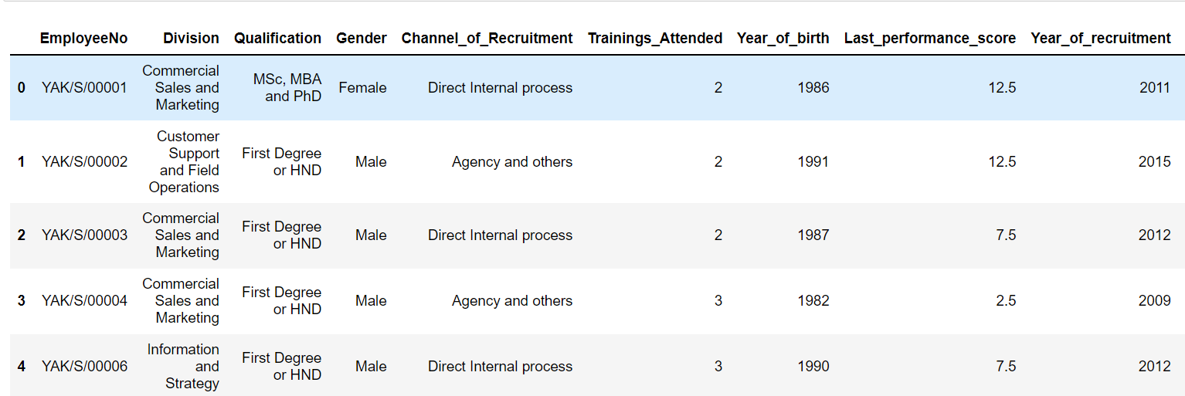
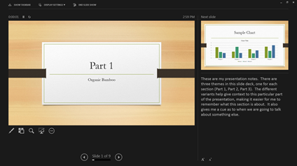
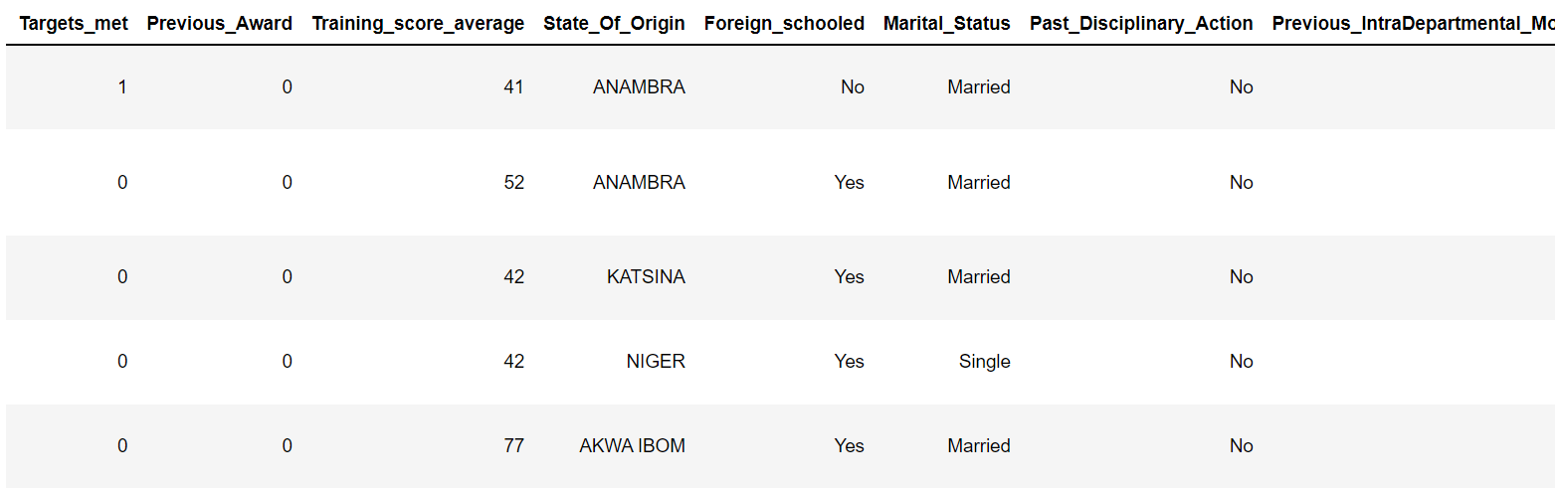
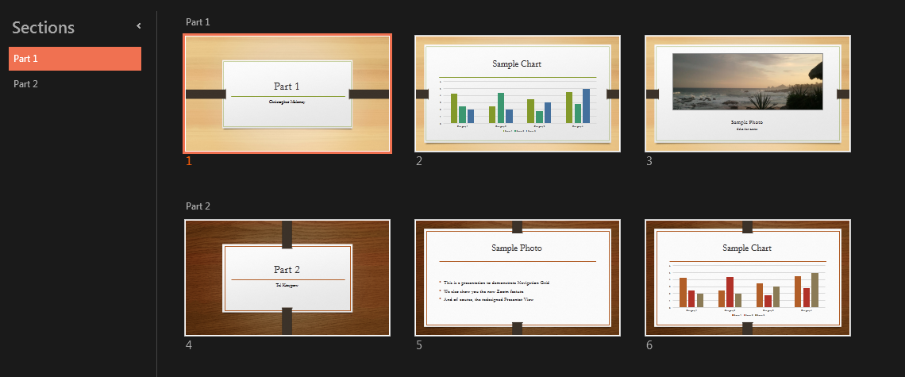
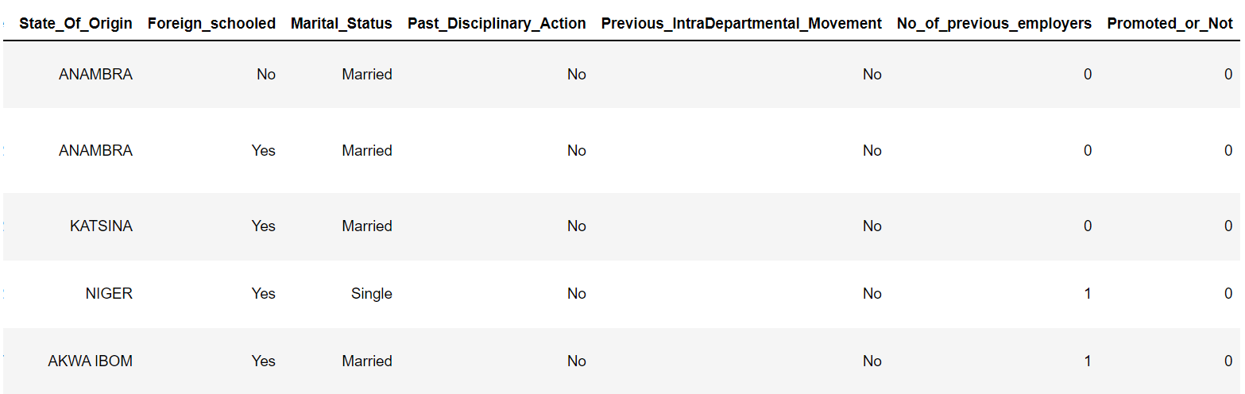
Visualization (A look of the dataset)

Slide 4
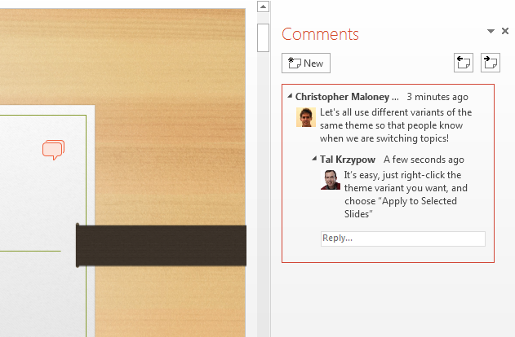
Analyzation
After analyzing, the total number of staff was,
Total Number Of Staff : 38312
Total Number Of Promoted Staff : 3241
Males : 26880
Females : 11432
Out of the Promoted 3241 staff, 2223 were males and 1018 were females.
After that, I checked the ratio of the each of the promoted gender with their total amount, and found that the females had a higher percentage.

Slide 5
Analyzation
Female Ratio : (1018/11432)*100 = 8.905% of the total population of females were promoted
Male Ratio : (2223/26880)*100 = 8.270% of the total population of males were promoted
The above Analyzation simply tells us that females have a higher probability of getting promotion
Marital Status was another consideration put in place:
Married Promoted Males : 80.61% of the total promoted males were married
Married Promoted Females: 82.9% of the total promoted females were married
Therefore: 81.33% of the total promoted population are married
NB:
3241 staff were promoted, 2223 were males,1018 were females
1792 males of 2223 males were married and 844 males of 1018 females
Simply tells us that being married is a high criteria for being promoted

Slide 6
Analyzation
From analyzing the staff qualification,
There were 3 different kind of qualifications:
1 - First Degree or HND with a total of 27257 staff holding this qualification
2 - MSc, MBA and PhD with a total of 10469 staff holding this qualification
3 - Non-University Education with a total of 586 staff holding this qualification
Of the staff with First Degree or HND only 7.98% were promoted,
Of the staff with MSc, MBA and PhD only 9.66% were promoted
Of the staff with Non-University Education only 8.73% were promoted
This explains that staff with MSc, MBA and PhD have a higher probability for promotion.

Slide 7
Analyzation
Also looked at the kind of school attended by the staff, Foreign Schooled or Locally Schooled
Of the total population of 38312, 34995 are Foreign Schooled, while 3317 are Locally Schooled
Of the 3241 staff, 2970 were Foreign Schooled, 271 were Locally Schooled
Gives 91.64% of the total promoted staff were Foreign Schooled, therefore,8.36% were Locally Schooled
Therefore being from a Foreign School, probability of getting promoted is very high
Targets
Staff were also given targets to meet in a period of time,
Out of the 38312 staff, only 13524 met up with their targets.
Only 16.9% of those who met their targets were promoted.
Therefore meeting up with companies target is not a high criteria…….(but make sure you always meet your targets ooo!)

Slide 8
Analyzaaaatiion 😫😫😫
Taking another feature into consideration (Past Disciplinary Action) this feature contains staff who have had their names written in a black book, by disobeying companies rules and regulations and also causing losses to the company.
Of the total staff, 38161 had clean record, while 151 had a stain on their record.
Of the 151, 10% were promoted.
So having a bad record, hinders your chances of getting promoted.
Another consideration is the (Division) feature, that describes the field each staff works, so we want to know which of the fields, has the highest promotion from past records.
The company has 9 different fields of work
Commercial Sales and Marketing – in which 7.19% were promoted

Slide 9
Customer Support and Field Operations – in which 8.83% were promoted
Sourcing and Purchasing – in which 9.68% were promoted
Information Technology and Solution Support – in which 10.74% were promoted
Information and Strategy – in which 9.35% were promoted
People/HR Management – in which 5.69% were promoted
Regulatory and Legal services – in which 5.59% were promoted
Research and Innovation – in which 6.17% were promoted
Business Finance Operations – in which 8.17% were promoted

Slide 10
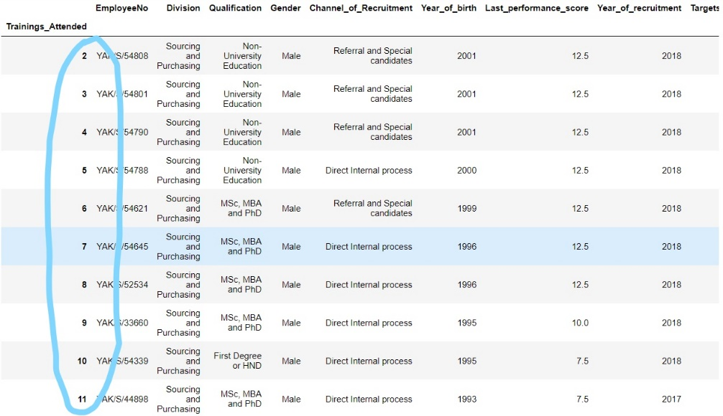
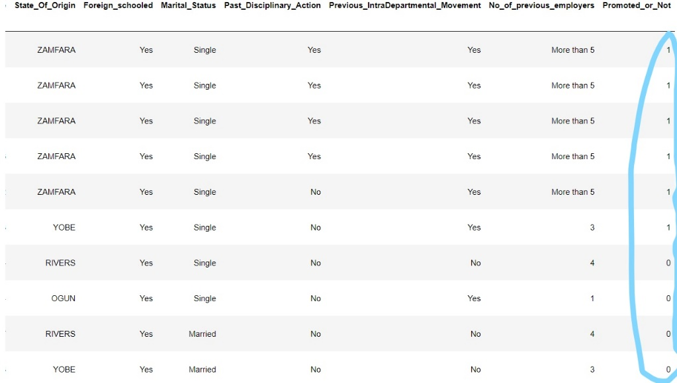
From the above we can see the various percentage of promotion in each field, so the fields determines if someone can get promoted or not.
Staff also attend training, on how to carry out their job. Therefore another feature(Training Attended)
This feature was categorized into a range of (2,11), from further Analyzation, we found out that staff who didn’t need much training before they could excel in their field of work, have a higher tendency to be promoted.
Grouping them, we have;

Slide 11
Another feature is the (Recruitment Time)i.e the time you joined the company. This does not really guarantee promotion, because in our dataset we see that staff who joined in a year like (1990) not getting promoted while a staff who joined in a year like (2016) getting promoted, yet they work in the same department.
So this is not a really strong predictive feature.
One last thing to consider is the (Channel Of Recruitment).This area covers how and what method you joined the company. It was categorized into three types:
Through Agency and others – 21310 staff of 38312 staff came in through this method, 1796 were promoted
Through Direct Internal Process – 16194 staff of 38312 staff came in through this method, 1347 were promoted
Through Referral and special Candidates – 808 staff of 38312 staff came in through this method, 98 were promoted

Slide 12
8.42% of the total staff who came in through the Agency and others were promoted
8.31% of the total staff who came in through the Direct Internal Process were promoted
12.13% of the total stuff who came in through the Referral and special Candidates were promoted

Slide 13
Conclusion
Company should ensure to also promote staff who did not attend foreign schools, as the difference between promoted staff who attended local school to those who attended foreign is very high.
Staff who met targets should also be encouraged by promotion.
Also, staff who have been in the company for long, growing alongside the company, requires encouragement.

Slide 14
Result(Conclusion)
From the analysis, we have seen the various possible criteria to meet, before you can be promoted as a staff.
THANKS FOR YOUR TIME
Find out more at the PowerPoint Getting Started Center
(Click the arrow when in Slide Show mode)
Notes:
In Slide Show mode, click the arrow to enter the PowerPoint Getting Started Center.

